Slide 1
Robotic Process Automation for Business Infrastructure Service
Version 7.5 – IBM INTERNAL USE ONLY
John Davis – Distinguished Engineer

Slide 2






IBM Services Platform with Watson Managing IT Operations
Broad & deep automation capabilities targeting everything we do
8
8. IBM Watson: evolves all automation and analytics to be able to achieve more e.g. to address non-deterministic use cases
1
2
3
4
5
6
7
Business Value
1. Automated Environment Build: Build compliant audit-ready, business-ready environments
2. Automated System Hygiene: Includes Continuous Compliance and Risk-based Continuous Patching
3. Dynamic Automation: Collation, Reduction, Automated Remediation, Measurement and Analysis of Events
4. Self Service Delivery: Self service implementation of pre-profiled automated changes
5. Robotic Process Automation: Automating both IT and business processes
6. Run Book Automation: Intelligently store operational procedures linked to down steam automation, enhancing human performance
7. Analytics, Measurement, Visualisation: Deep insights to focus automation activities and pre-emptively improve
Build Manage Change Run

Slide 3
Robotic Process Automation

Slide 4
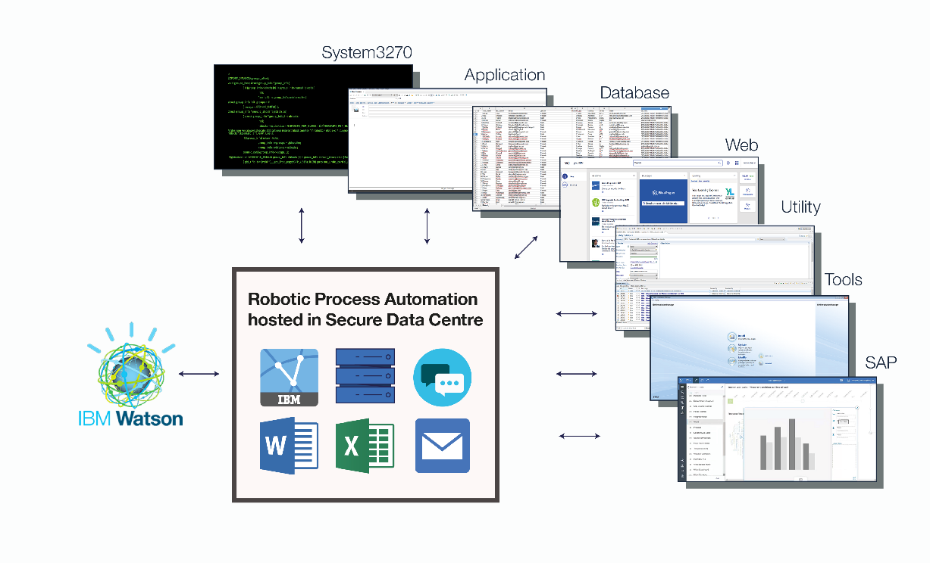
Overview
Robotic Process Automation:
removes the human element from a multistep repeated task; often involving relationships with other tasks,
emulates human execution from a workstation using screen and keyboard to drive applications and execute system-based work,
provides a virtual workforce controlled by the business operations teams and
sits alongside existing infrastructure, governed and controlled by IT.

Slide 5

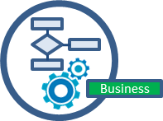


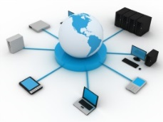
How is IBM applying Blue Prism?
Outsourced Process Execution
Increasing efficiency and performance where business processes have been outsourced to IBM.
Robotic Process Automation for Business
SaaS to support all back office functions like accounting, procurement, order processing etc.
SaaS Service includes hosting + consultancy services + link to Watson for Cognitive RPA
Application Support
SAP, Identity Administration, Project Management Tasks etc.
IBM Corporate
Outsourcing Infrastructure Support
Finance, Resource Administration, Procurement & Asset Management
Service checking, bridging, swivel chairs, dispatching work, avoiding event floods through enabling maintenance windows etc.

Slide 6
What did we do?

Slide 7
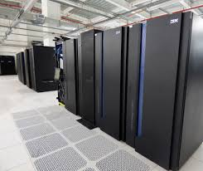




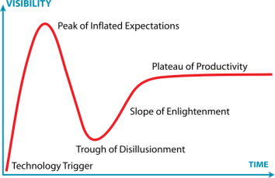


Expectations of RPA
Enterprise strength: run in the Data Center and be monitored like any other enterprise application
Reliable: allow the development of reliable robots that are resilient to issues encountered during the execution of the process
Resilient: any failure of robots to execute will render essential work undone.
Reusable: content reusable across multiple instances of the same process, and content components reusable across different processes
Secure: so as not to compromise any security or business compliance regulations
Ease of Enablement: content development, education, documentation, roadmap
Scalable: to allow tasks to be executed faster by applying more robots if required.
Cost justified: the TCO vs. benefit has to be positive

Slide 8
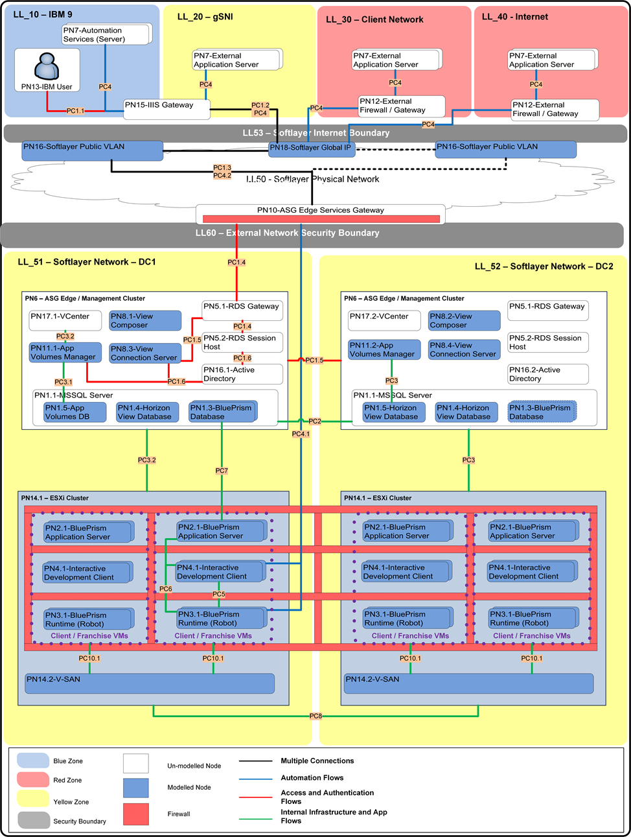
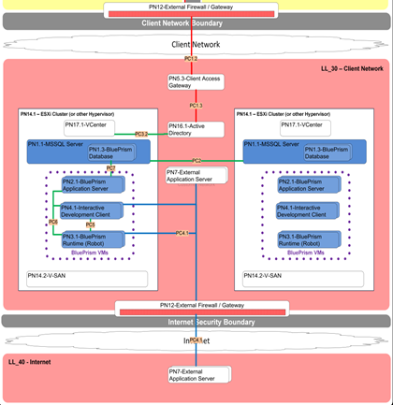
A lot of Architecture – Dual Site, ESX, NSX, Fully Managed etc.

Slide 9












A lot of Organisational Enablement
Executive Sponsor
End to end architecture.
Infrastructure deployment patterns, SoftLayer, appliances, shared capabilities etc.
Centralised implementations.
Oversight of Security Architecture.
Oversight of Network connectivity etc.
Establishing the support model etc.
Program Manager and Project Manager
Lead Architect
Delivery Execution Owners (of to be automated)
Responsible for talking to delivery teams
Gathering use cases
Managing the scorecard
Getting questions answered
One initially (a service increases other may be needed per Geo or IMT will depend on how much gets franchised)
Responsible for getting started quickly on globally re-usable use cases, and those with big value
Responsible for mentoring the Franchises on their developments
Development of re-usable Objects for the Franchises (and validation of objects that the Franchises recommend to share)
Mentoring, reuse and Common Object exchange
Small Central Global Development Team
Pipeline Manager (*)
Pipeline & Results Tracking
Responsible for the care and maintenance of in production automations.
Franchised Development Groups – Self service automation creation
(at a Service Line, LOB, Geo or IMT level)
BAU Run Process Managers
RPA Service Mgr
Working locally, in control of their own destiny should mean the role is less required.
Franchises may choose to appoint their own if this proves not to be the case.
Delivery Execution Owners (of to be automated)
RPA Hosting Support Organisation

Slide 10
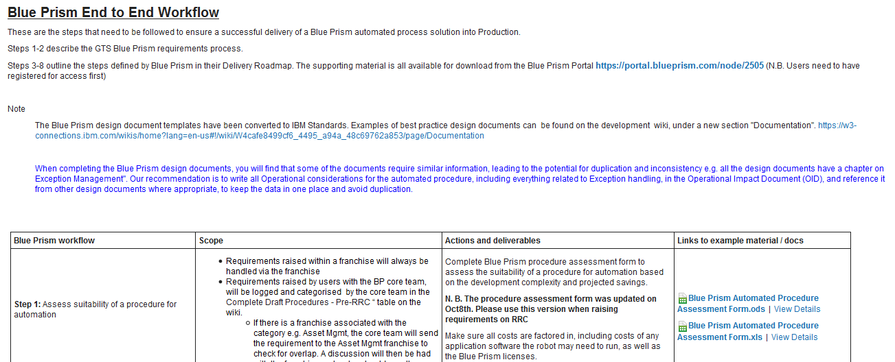
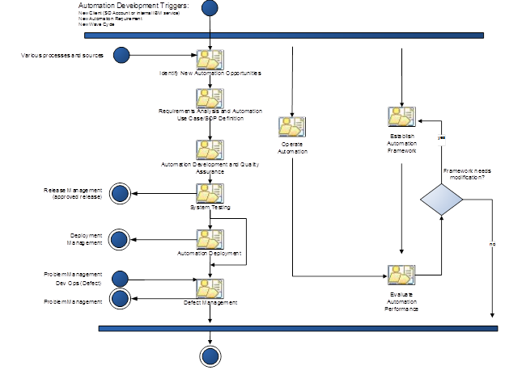
A lot of Process Implementation

Slide 11

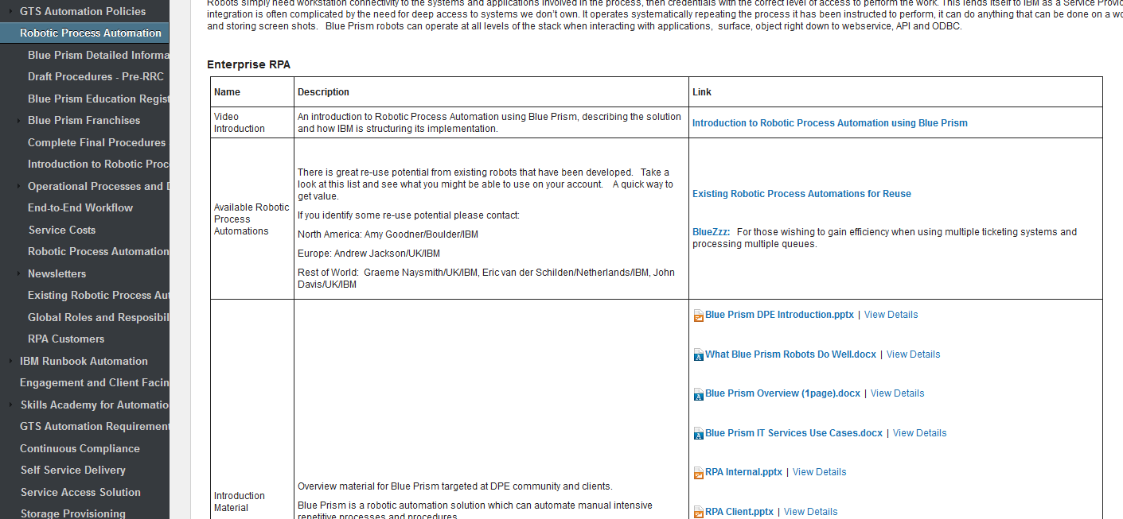
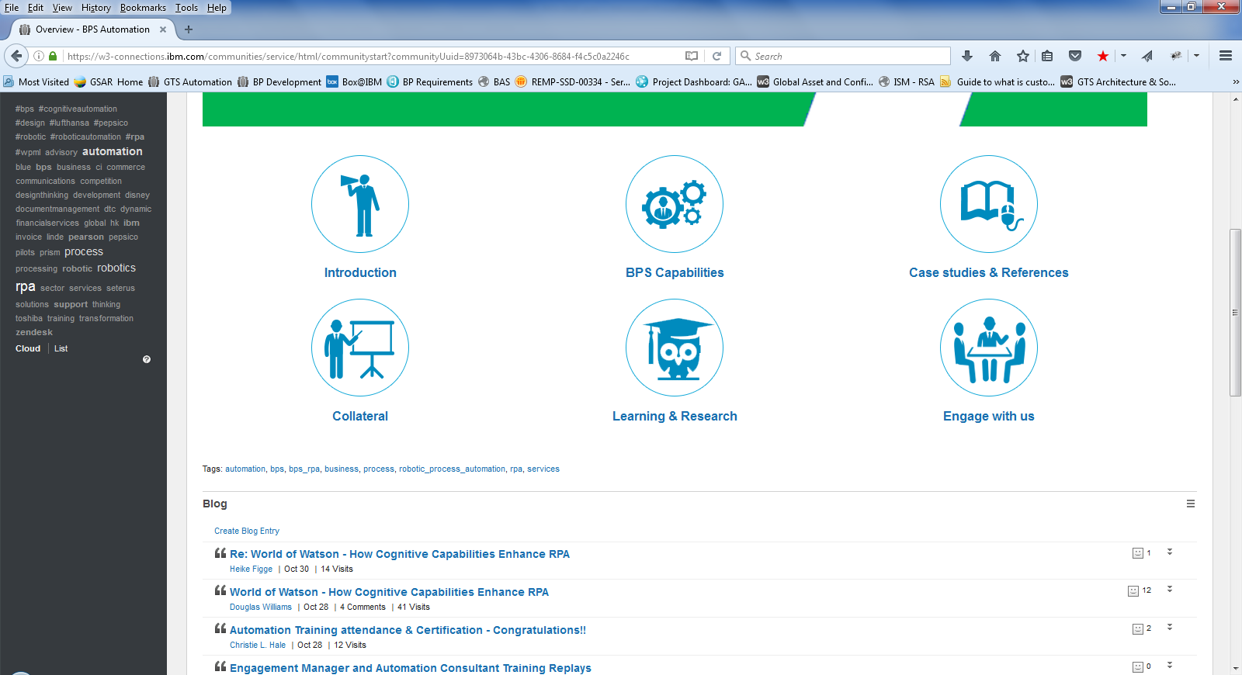
A lot of Communication
IBMers
Clients
3rd Party advisors
Analysts

Slide 12
Service Overview

Slide 13
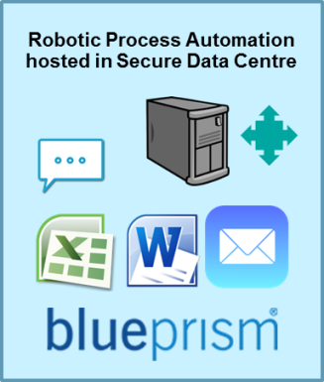
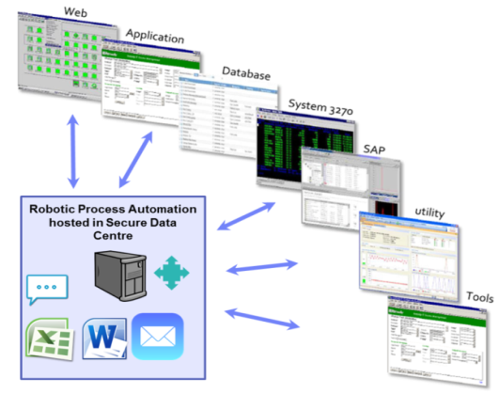
Robotic Process Automation as a Service – Focus on Content not Infrastructure
Scalable, usage based Service
Secure Hosting
Hardware & Software Licences covered
Rapid Installation
Lifecycle Management
Systems Management
Service Management
24x7x365 Support
Dual site redundancy
Cognitive Ready
Business Consultancy
Opportunity Identification
Proof of Concepts
Design
Development
Test
Deploy RPA content
Exclusive
RPA Environment
Business use cases
IT use cases
On the same platform and down the same pipe
Client Business Operation Environment

Slide 14
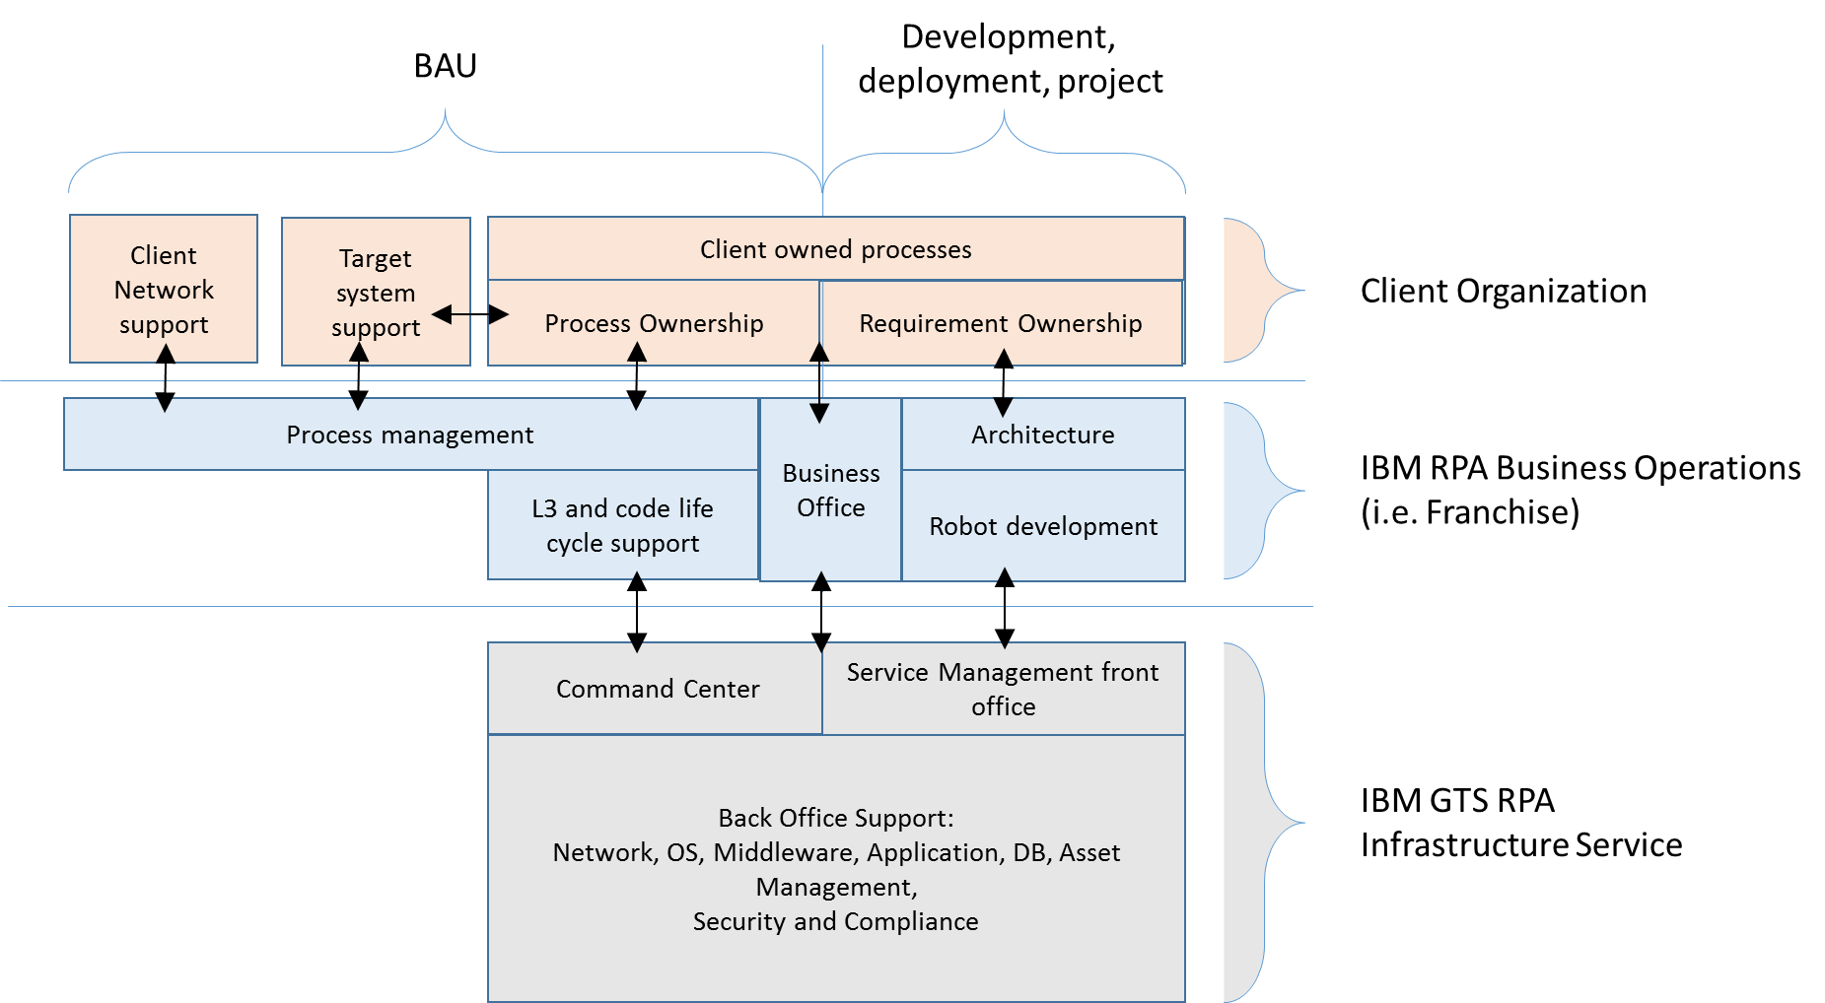
Service Model
In order to provide RPA BluePrism automation, IBM recommends to establish a set of Business Operations services. The GTS RPA Infrastructure Service is represented below in Grey.
The Business Operations services, which are represented in Blue:
interlocks with the business organization throughout the solution life cycle and
builds, manages and maintains robots.
Clients can provide these services themselves, or ask IBM GBS to deliver this service.

Slide 15
Infrastructure Service Cost
Regular Service | Exclusive Service
US$ 850 per Production robot per month US$ 625 per UAT robot per month (1 free robot) US$ 625 per Dev robot per month (1 free robot) Not included in the cost: VPN network connectivity components on the client side Process Specific software licenses Process or client specific network connectivity | US$ 1500 per robot per month for the first 5 Production robots US$ 850 per additional Production robot per month Regular Service Dev and UAT robot costs Minimum of 3 months (billed monthly) Not included in the cost: Same components as the Regular Service

Slide 16
Example Use Cases

Slide 17
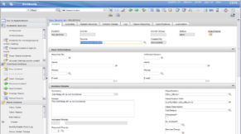


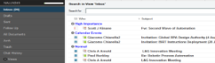
Cognitive Improves Effectiveness of Automation Solutions: email to Ticket Bridge
What is the communication about? Where should it be sent for resolution?
0. Ticket Data used for Cognitive Learning
2. Email content sent for Cognitive Assignment
8. Ticket created or updated and assigned to correct resolver group
4. Best assignment destination and ticket attributes based on ticket content
6. Mail Content in non-English
Language Translation
3. Remediation Data for Software + Account Knowledge Base
5. Proposed remediation tasks based on ticket content
7. Mail Content translated to English
1. Emails read in from task ID
Knowledge Bases
Reduced time to resolver
Accurate assignment
In resolvers language
Enriched with resolution help
Scale to meet volumes
Reduced manual effort
Can be applied to run against Contact us: XXX@customer.com?

Slide 18
Potential Opportunity Throughout the Business
Back Office Administration and Reporting | Digital and Online Services | Customer Support and Service Desk | Data Migration and Management
Business Service Centre. Processes for Internal user or customer support desks for customer support, technical support and help desk activity | Online Service Catalogue. Allowing customers to self-serve any automated process available in the online service catalogue. | Customer Management. New account creation, change of details, updating records in CRM systems | Application migration. Migration of application data, records and history as part of an upgrade or migration project. Examples include customer records systems, ticketing tools and CRM systems
Human Resources. Automation of activities such as payroll and absence management, starter and leaver processes and employee data management | Consumer Channel Shift. Replacing high volume consumer phone, email and mail based requests with real time automated execution via an online presence to reduce cost and improve customer experience | Access Management. Validating identity, unlocking accounts, resetting password credentials across enterprise and bespoke applications of all types | Data-rekeying. Simulating user rekeying of data from one system to another where standard system integration approaches are not viable. This includes external (e.g. supplier, competitor or customer) systems and can be deployed as a temporary or permanent fix
Finance & Accounting. Automation of accounts payable, accounts receivable, order management, invoicing, collections and reporting processes | Digital by Default. With customers demanding on-line access, avoid the need to redevelop or replace applications by linking web interaction to legacy back-end systems and processes | User Administration. Changes in processes across multiple systems and applications | Information Validation and Auditing. Cross referencing data sources to validate and inspect information and provide compliance and auditing outputs
Procurement. Request management, approval and sign-off, supplier management, invoice reconciliation and asset management processes | Secure Access to Applications. Allow users the ability to interact with business applications or processes without being exposed to system complexities or require individual application user accounts | Change Management. Recording change requirements, following approval workflows, executing changes across systems | Legacy Enablement. Using the virtual workforce to interface disparate and legacy systems, replicating data translation and data rekeying
Supply Chain. Including automation of demand management, supplier and supply management, management of transportation and inventory processes |  | Request Management. Managing and executing user requests using customer bespoke processes | Customer & supplier system integration. Providing an electronic interface to customer and/or supplier systems where a system to system interface is challenging or not possible
Customer Experience Management. Processes including customer support, technical support, billing and account management and customer loyalty programs |  | Incident Management. Managing the raising of incidents, creation of tickets, and end to end resolution of common issues, or escalation to an appropriate human resolver | Swivel chair processing. Replacing the mundane human activities involving transposing information between applications, spreadsheets, documents and systems – and removing the high instances of human error
Reporting. Processes for the generation of regular reports which require data extraction from multiple sources and manipulation into a report output. |  | Problem Management. Managing escalation of incidents, feeding problem queues, alerting resolver groups, initiating major incident procedures | Synchronising Systems of Record. Updating internal and external systems or record simultaneously between different tools, across organization, company boundaries, internal and external parties
 |  | Progress Chasing. Managing update requests, progress reporting and removal of human effort from users looking to understand status of request or requirement
 |  | Billing and Account Queries. Resolving queries on customer accounts (technical and administrative)

Slide 19

Automation Improves Effectiveness of Cognitive Solutions
Legacy Core Business Backend Systems
On-line Client Facing
Front Office
API calls if the enterprise has transformed it’s
legacy estate
… “air gap” if not.
Front Office can promise action, but humans have to execute.
Watson provides the “Cognition” while RPA provides the “motor” to get the resulting work done – Watson calls the Robot via API
As legacy transforms remove robots… but don’t wait take value now!

Slide 20
Resources in IBM

Slide 21
Resources
RPA for Business Infrastructure Services: https://eitaasmarketplace.ibm-gts.us-south.mybluemix.net/EITAASMarketplace/jsp/details.jsp?category=1&service=3
RPA with Watson: https://ibm.box.com/s/fz0vulk9pwdjfnnd1tr85di4so2qu56z
Architectural Overview: https://ibm.box.com/s/rcn9e0wnvf8kal9jnhhr8045e41x28uf
Network Connectivity Options: https://ibm.box.com/s/9czezzxzyf1s4vana8u19wynlf3xf5jf
Terms & Conditions: https://ibm.box.com/s/ev8tcvc8p3ty6hpo6zkxjiqyz28q9dc0
RPA Wiki: https://w3-connections.ibm.com/wikis/home?lang=en-us#!/wiki/W15686524f2bf_458d_bbd4_f66c6c28fefc/page/Robotic%20Process%20Automation

Slide 22
Contacts
Programme Manager: Eric van der Schilden - eric.vanderschilden@nl.ibm.com
Delivery Project Executive: Rohit Ogale - rohit.ogale@cz.ibm.com
Chief Architect: Harish Verma - harish.verma@in.ibm.com
Franchises Manager: Colin Hutchon - colin_hutchon@uk.ibm.com
Lead Developer: Thijs Post - thijs_post@nl.ibm.com
Enterprise Architect: Giacomo Chiarella - giacomo.chiarella@uk.ibm.com
Distinguished Engineer: John Davis – john_davis@uk.ibm.com

Slide 23
Thank You!

Slide 24
Lessons Learned from IBM Adoption

Slide 25
Lessons learned
Infrastructure
Having an industrial strength solution that can scale, is secure, can be run within the data centre is important but its enabled by the Infrastructure Design applied to the implementation.
NSX is can be used for easing the challenges of micro segmentation between environments
The reliance on .net remoting secure communications between system components was challenging as IBM does not have Active Directory installed internally (but we do now!)
Content Development
Perform pipeline management – maintaining and managing a pipeline of automation opportunities
Anyone can create a desktop screen scraping utility to do something simple quickly. It is much more involved to create an industrial strength reliable automation that can deal with all possible application and process exceptions.
Creating automations must be done following a rigorous development approach, by experienced developers
Understanding and fully documenting the way the process operates today, extracting what is often tacit knowledge, is challenging.
Having the flexibility to work at all levels of the integration stack is very important – API’s are brilliant!
The act of focusing on processes to automate can lead to process optimisation and different end solutions.
Sometimes needed a human trigger utility.
IT use cases are very fragmented in terms of savings yield, we don't tend to find 100s of people doing the same thing.
IT use cases took longer to develop than we expected, by contrast business process use cases a lot quicker.
Reuse of objects is important for time saving.
Citrix automations (surface) should be avoided.

Slide 26
Other Lessons Learned
Support
Managing application stacks can be simplified using app stack and horizon view
Post change implementation testing rigor is important.
Geographically dispersed use case, but with High Availability needs – there is no simple window for down time
The license counting reporting to calculate max concurrency needed to be bespoke written.
Getting robot IDs provisioned and the necessary network paths open are a long pole.
A gate review process is essential to ensure quality robots are passed to production and the necessary support materials are in place.

Slide 27
RPA for Business Infrastructure Service
IBM GTS’s Infrastructure Service delivers a cost effective, fully managed hosting environment for robots on the Private Cloud.
Hosted securely in IBM's Data Centre, it provides a scalable, usage-based service where hardware, software, lifecycle, service and systems management are all covered 24x7x365
Dual site redundancy (London & Amsterdam)
Two Service Options – Shared (Regular) or Dedicated (Exclusive) Environments.
Dedicated Secure IPsec VPN Tunnel connection from the client environment to the RPA Environment
Outsourcing RPA hosting to GTS gives you the best economies of scale and experienced teams to manage your automation.

